Slide 1
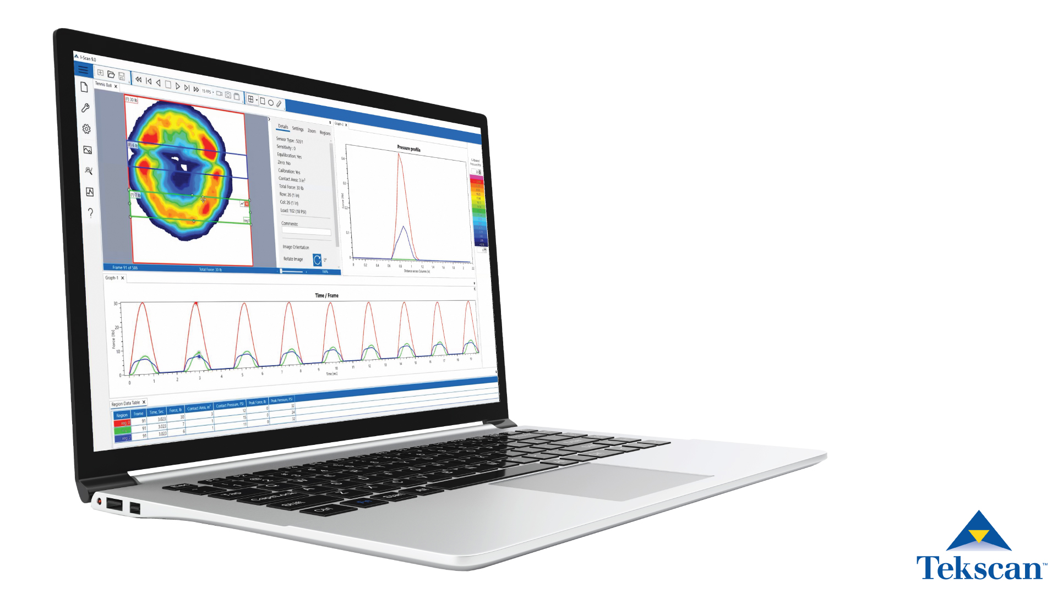
I-Scan 9.0 Software Release

Slide 2
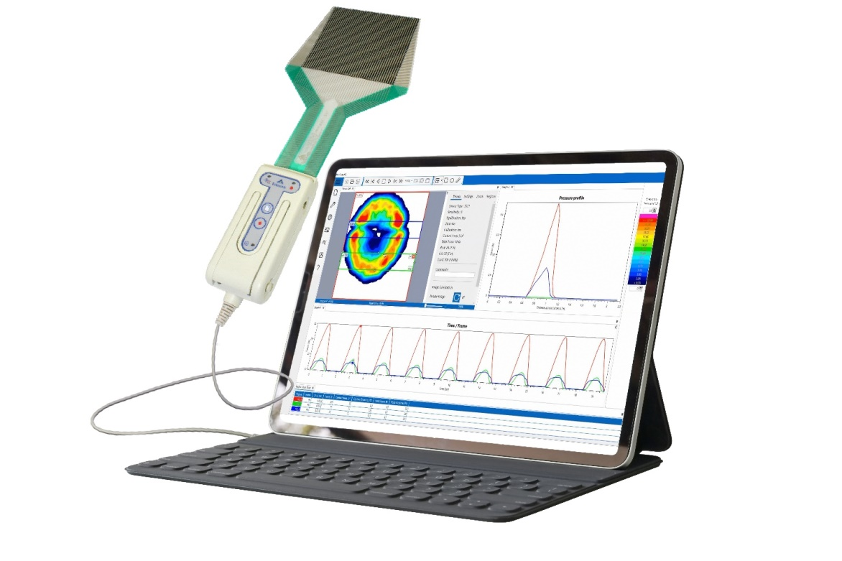
I-Scan 9.0: A Modern Software Portfolio
  1. Streamlined sensor configuration and set-up
  2. Simplified user interface to compare and analyze data
    Make analysis more intuitive
    Easy to compare data & see critical parameters
    Manage workspace with data window display options
  3. Improved Analysis options
    Easy to compare multiple recordings
    Rapid graph creation
    Integrated property table
  4. Web-based software updates
    Automatic notification of update download availability
Improve productivity for data collection and analysis

Slide 3
Streamlined Sensor Configuration & Setup
Recommended process flow for sensor step

Slide 4
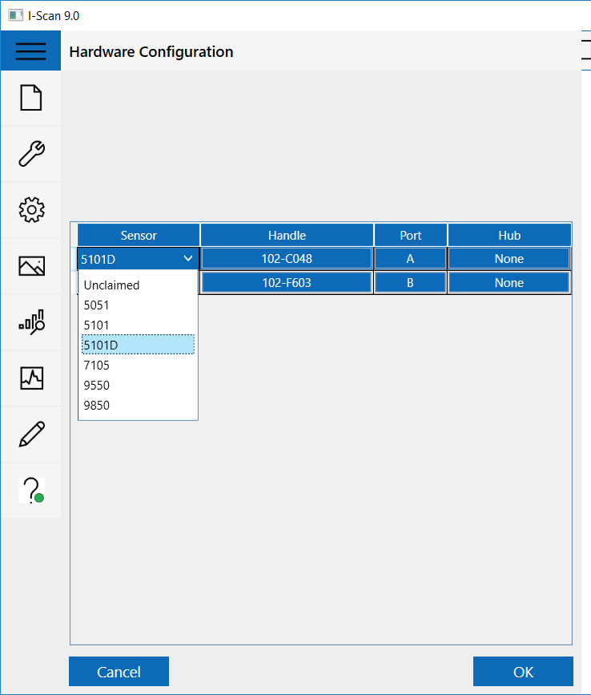
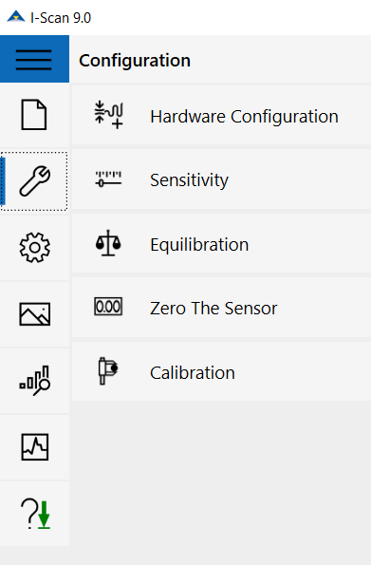
Streamlined Sensor Configuration & Setup
Improved efficiency and process flow for sensor set-up
  Save time in future sessions with remembered settings
  Define test parameters up front
  Ensure all steps are taken to collect accurate data

Slide 5
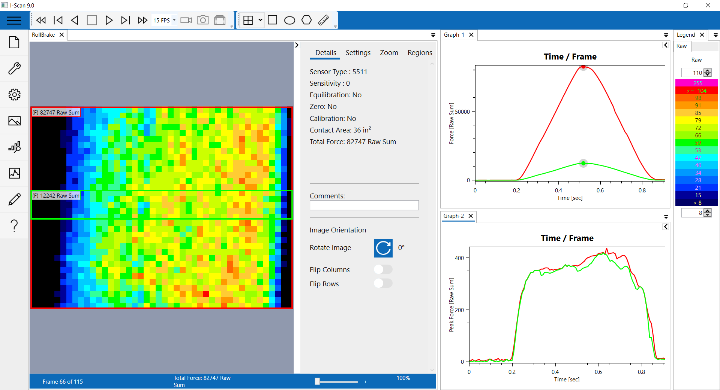
New Display Options for an Organized Workspace
Display data, graphs or chart windows in a variety of ways
  Docked windows to maximize real estate for displaying data
  Split screen to view
  many data sets at once
  Tab windows to prioritize
  important data sets
  Auto docking of windows
  will simplify demo process,
  allowing prospects to instantly
  see the valuable information
  provided by the software

Slide 6
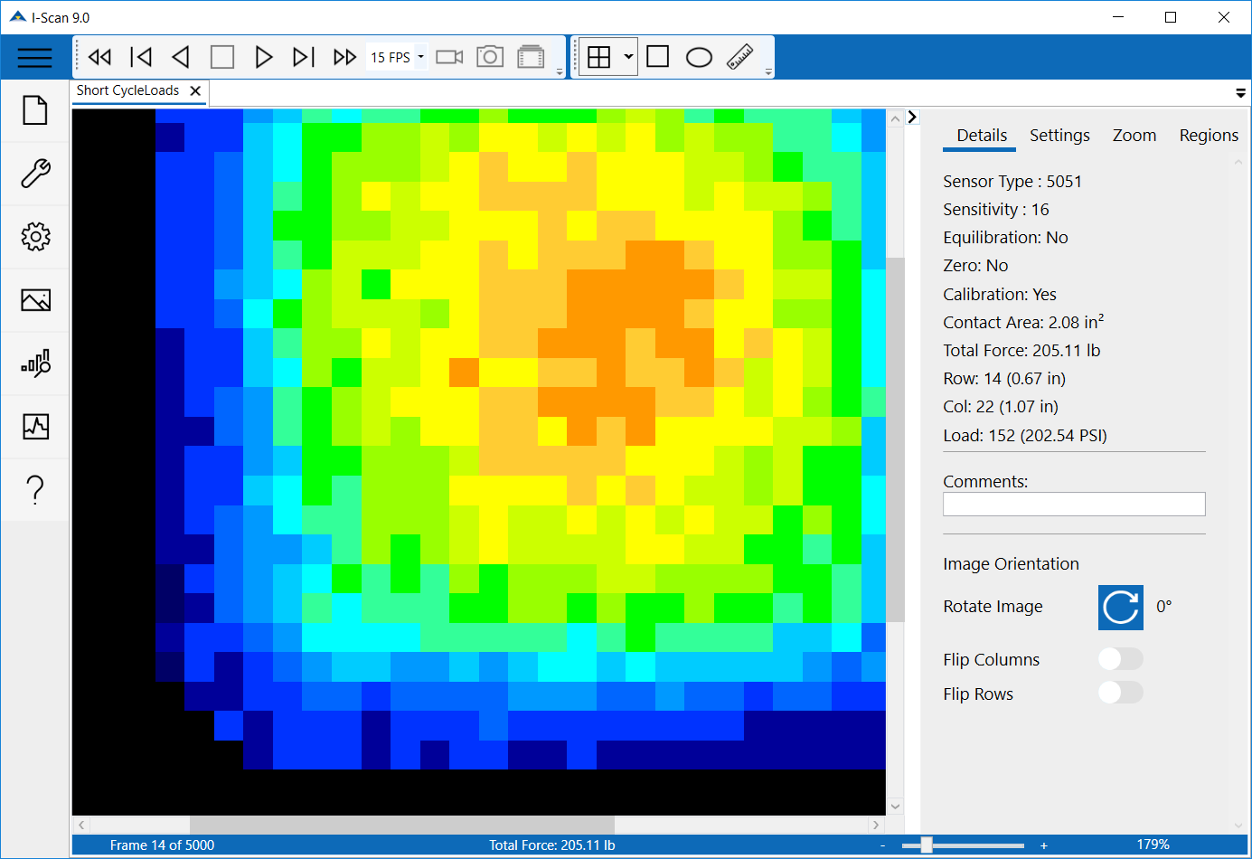
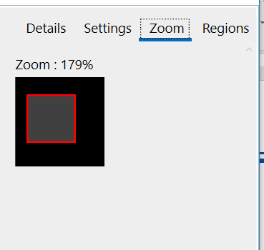
Improved Display Controls
Key data is displayed in the details panel
Zoom in to see details in a variety of ways:
Slide bar
Click to zoom region
Scroll wheel on mouse
Move zoom region from zoom tab

Slide 7
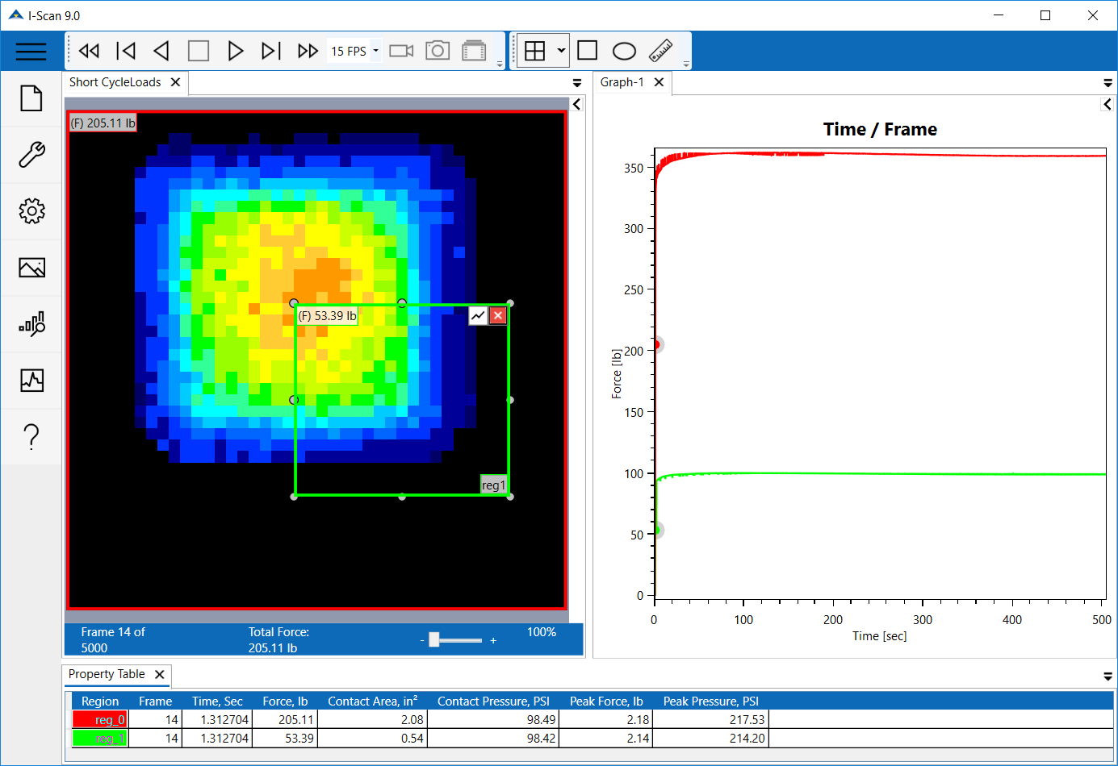
Enhanced Region Analysis for Detailed Insights
Display data, graphs or chart windows in a variety of ways
  Quickly create analysis graphs (pop up icon on pressure window)
  Easily modify for more complex analysis
  Compare key values in all regions of multiple recordings in property table

Slide 8
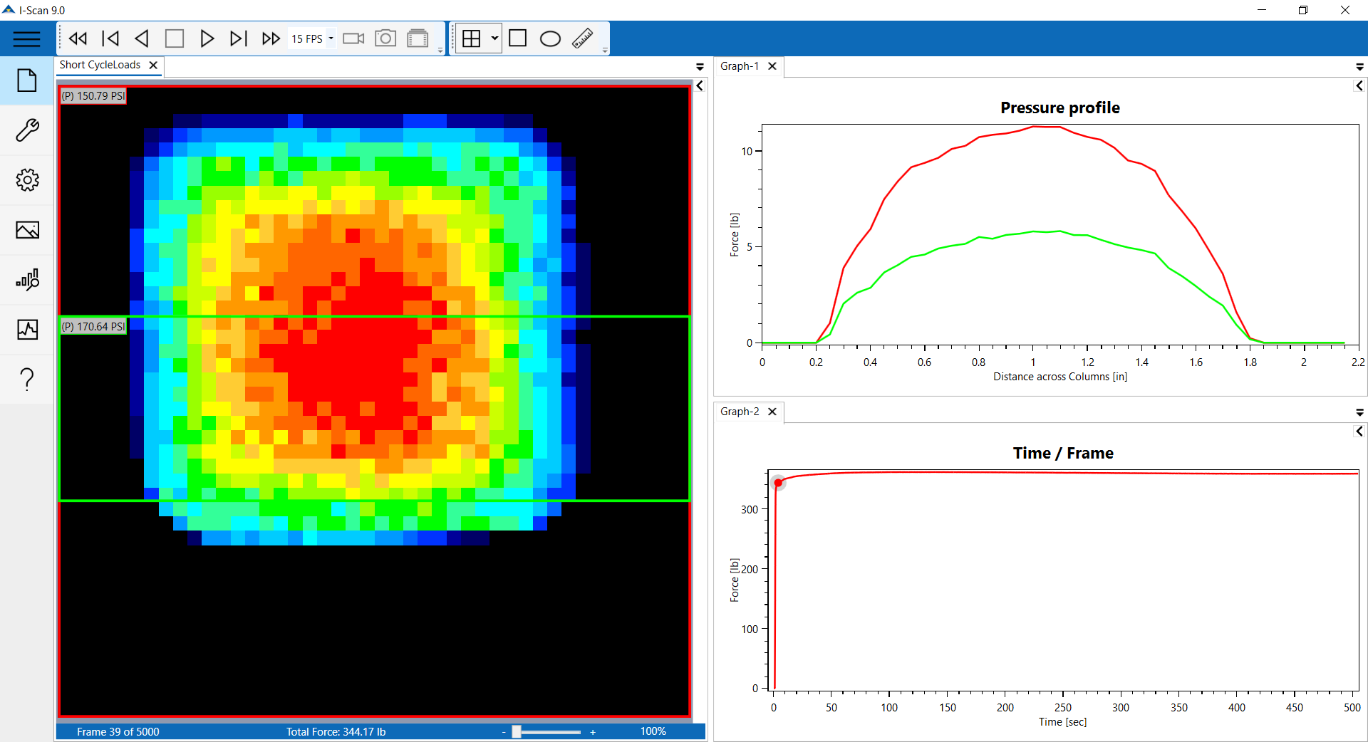
Analysis of multiple Parameters
View multiple graphs simultaneously
Improved graph creation and modification for more complex analysis

Slide 9
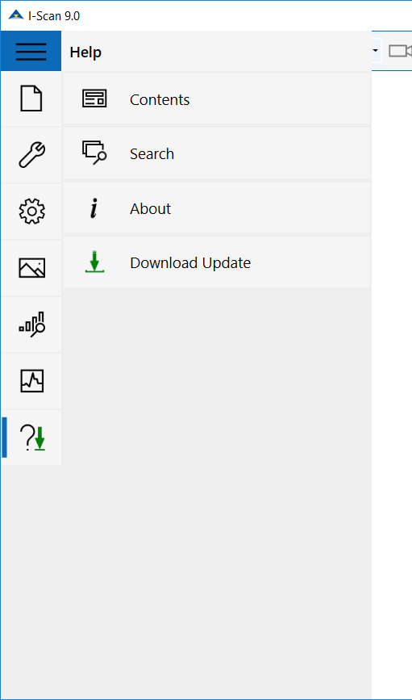
Efficient software updates
Simple click of a button (when connected to internet) triggers download of global bug fix updates
Users automatically informed of version update downloads
  No need for download links or CDs to be shipped
Future releases will allow software changes (new maps or additional features to be pushed)

Slide 10
How I-Scan 9.0 improves usability
Complex data analysis for R&D
    Easier to organize workspace when comparing multiple data sets
    Quickly configure graphs for in depth analysis
    Conveniently display data in multi-handle applications
Quality Control applications
    Set layout for matching data to “Pass” parameters
    Details panel and property table to quickly see key metrics
Enhance data collection with more efficiency from new user interface
Notes:
Consolidate with

Slide 11
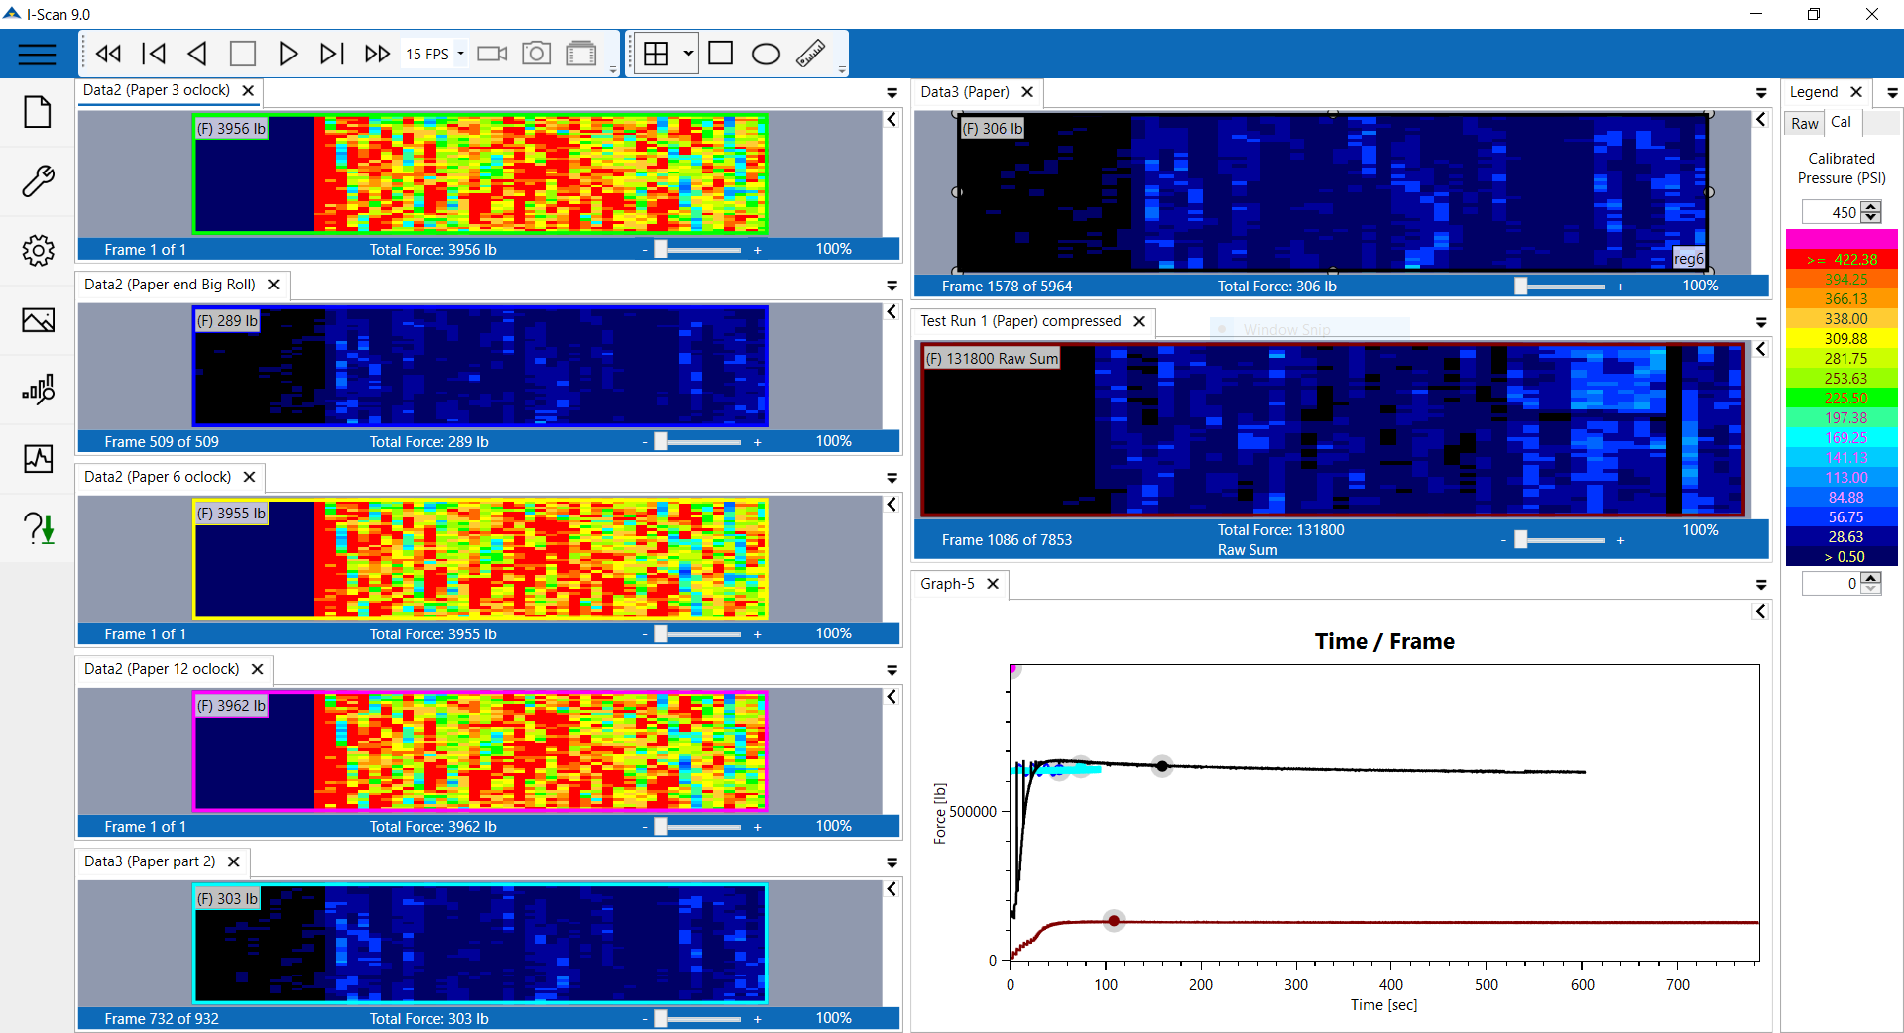
Organize Complex Data Analysis
Windows can be pulled from software window and displayed on second screen

Slide 12
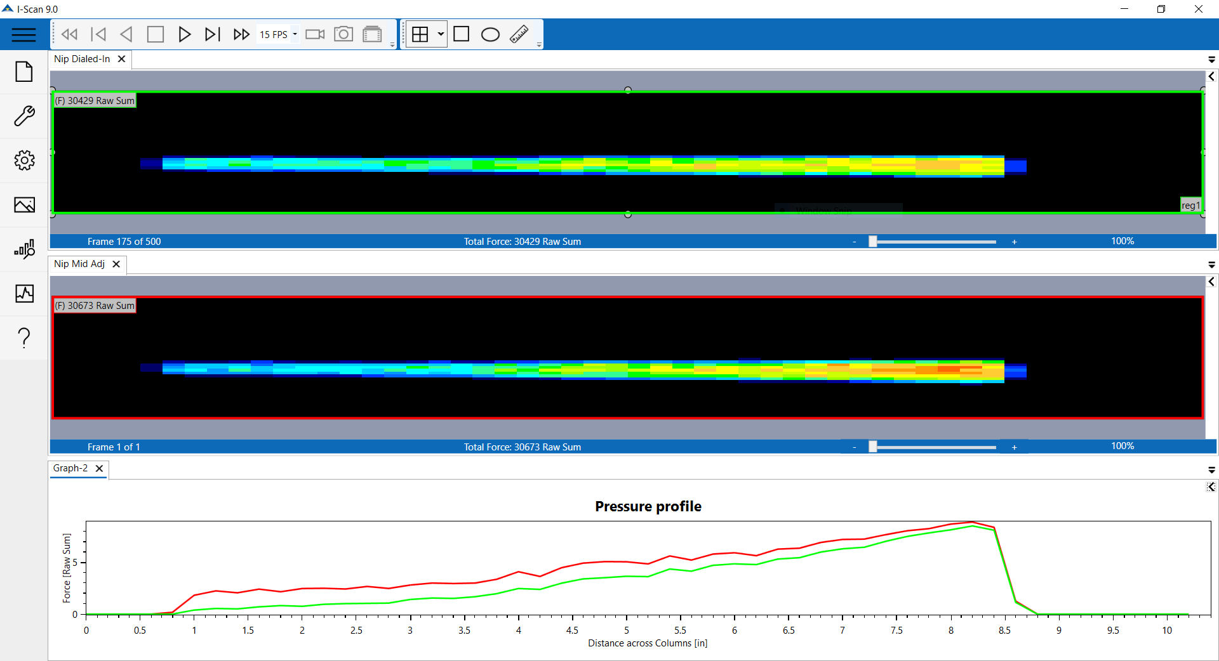
Simplify Quality Control Applications
Docked windows maximize real estate of data images

Slide 13
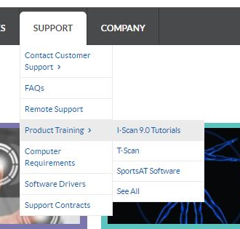
Available Tools: 7 Step-by-Step Tutorial Videos
Located on a “Training Video” section of the Tekscan Website – all 1-minute or less
  How to use the details panel and pressure analysis tools
  How to set acquisition parameters and record data
  How to group, tab, and reorganize windows
  How to create graphs and tables to analyze specific regions
https://www.tekscan.com/i-scan-90-tutorials

